Slide 1
Introduction to M Programming for the Power BI Warrior

Slide 2






Thanks to the Forefathers of M Education
Matt Masson
https://www.mattmasson.com/tag/m/
Chris Webb
https://blog.crossjoin.co.uk
Reza Rad
http://radacad.com/blog

Slide 3
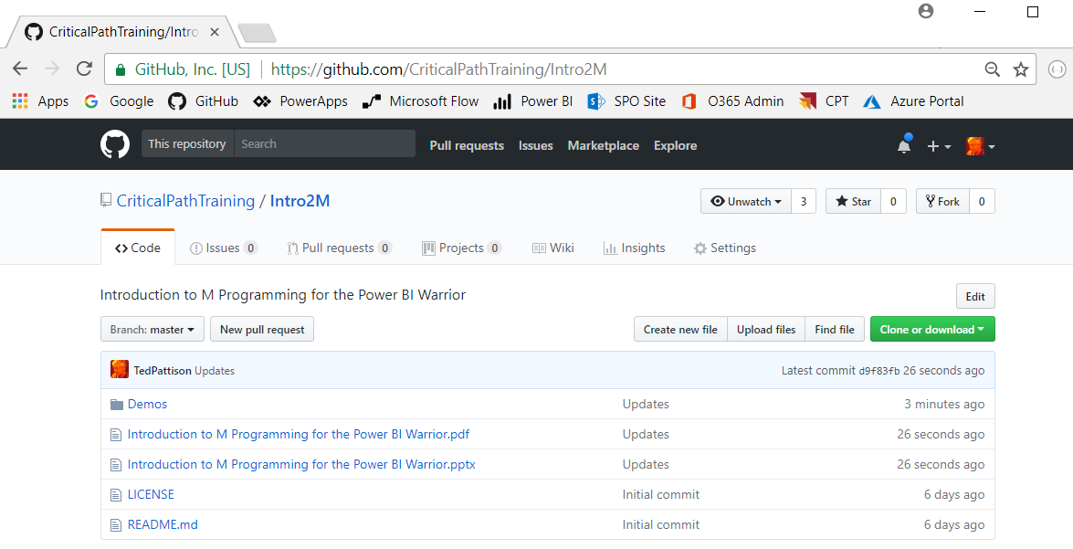
Download the Code and Slides
https://github.com/CriticalPathTraining/Intro2M

Slide 4
Agenda
Power Query Mashup Engine
M Programming Fundamentals
M Function Library
Query Functions
Query Parameters
Custom Data Connectors

Slide 5
Power BI Desktop is an ETL Tool
ETL process is essential part of any BI Project
Extract the data from wherever it lives
Transform the shape of the data for better analysis
Load the data into dataset for analysis and reporting
CSV
File
Power Query
Mashup Engine
Power BI Desktop Project (PBIX)
Dataset
Excel
Workbook
OLTP
Database

Slide 6
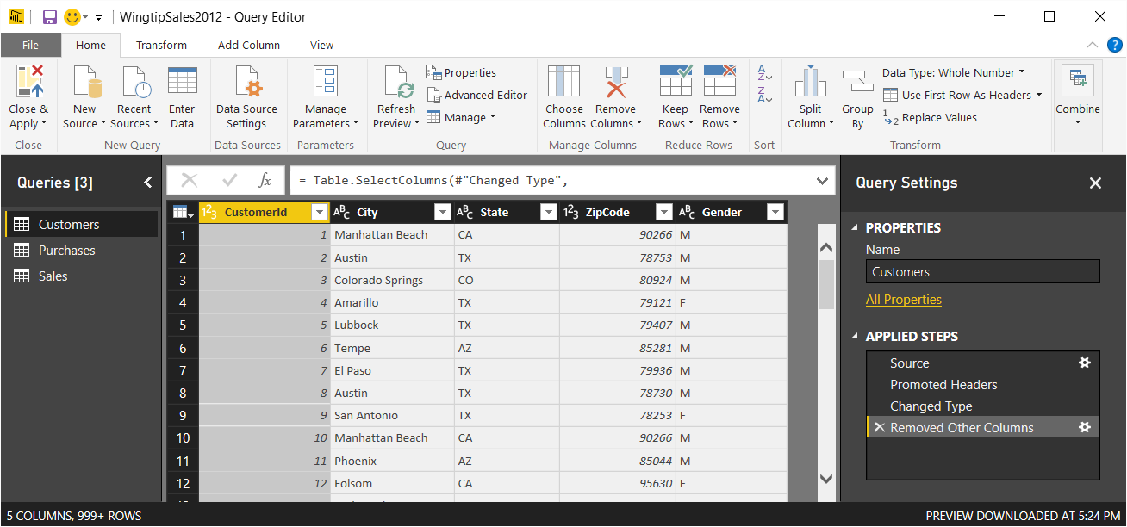
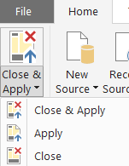
Query Editor Window
Power BI Desktop provides separate Query Editor window
Provides easy-to-use UI experience for designing queries
Queries created by creating Applied Steps
Preview of table generated by query output shown in the middle
Query can be executed using Apply or Close & Apply command

Slide 7
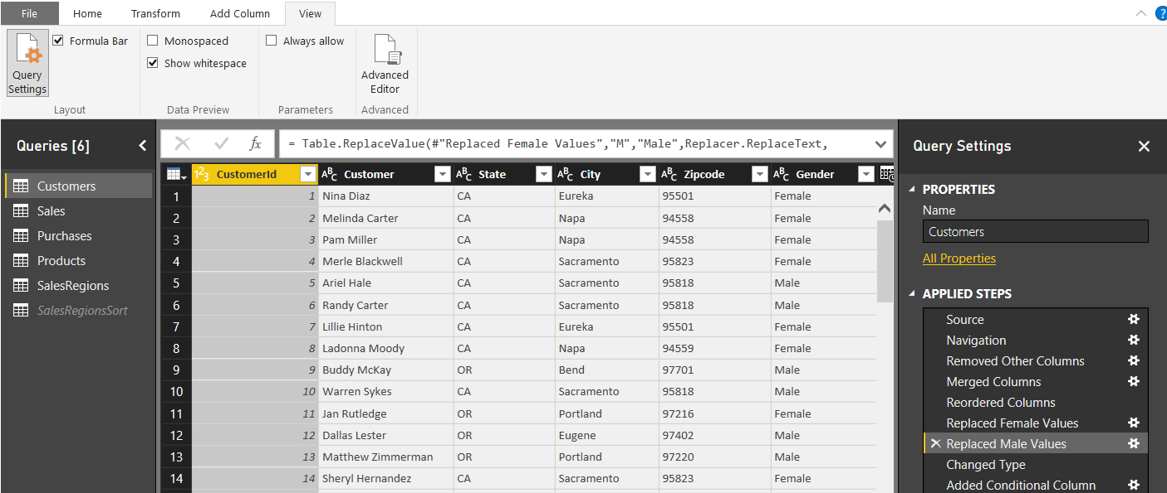
Query Steps
A query is created as a sequence of steps
Each step is a parameterized operation in data processing pipeline
Query starts with Source step to extract data from a data source
Additional steps added to perform transform operations on data
Each step is recorded using M (aka Power Query Formula Language)
step formula bar
sequential list of steps for query

Slide 8
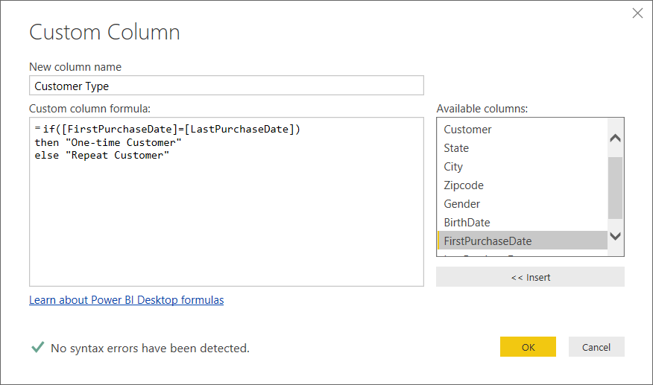
Custom Column Dialog
You can write M code directly for custom column
The Custom Column dialog provides a simple M code editor

Slide 9
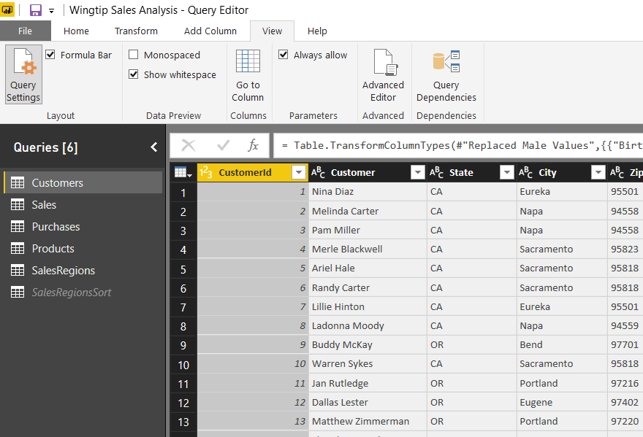
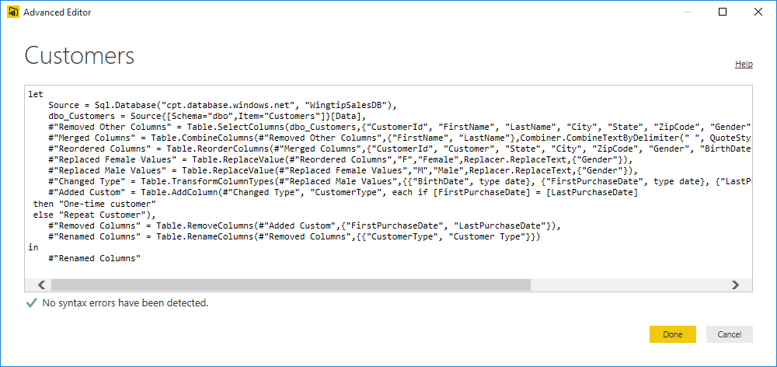
Advanced Editor or more correctly - The Simple Editor for Advanced Users
Power BI Desktop based on "M" functional language
Query in Power BI Desktop saved as set of M statements in code
Query Editor generates code in M behind the scenes
Advanced users can view & modify query code in Advanced Editor

Slide 10

"More" Advanced Editors
Lars Schreiber’s M extension for Notepad++
https://ssbi-blog.de/technical-topics-english/power-query-editor-using-notepad/
Visual Studio Code with M Query Extensions
https://insightsquest.com/2017/10/05/m-query-extension-for-visual-studio-code/
Visual Studio 2017 (or 2015) with the Power Query SDK
https://marketplace.visualstudio.com/items?itemName=Dakahn.PowerQuerySDK

Slide 11

Why Learn M
Accomplish things that cannot be done in query editor
Working with query functions
Performing calculations across rows
Navigate to SharePoint list by list title instead of GUID with the ID
Author queries and check them into source control system
Add query logic in .m files and store them in GitHub, TFS, etc.
Ensure query logic is the same across PBIX projects
Stay Ahead of the Pack and Win Admiration of Your Peers
People will think you are buddies with Chris Webb!

Slide 12
Agenda
Power Query Mashup Engine
M Programming Fundamentals
M Function Library
Query Functions
Query Parameters
Custom Data Connectors

Slide 13
The M Programming Language
M is a functional programming language
computation through evaluation of mathematical functions
Programming involves writing expressions instead of statements
M does not support changing-state or mutable data
Every query is a single expression that returns a single value
Every query has a return type
Get Started with M
Language is case-sensitive
It's all about writing expressions
Query expressions can reference other queries by name

Slide 14
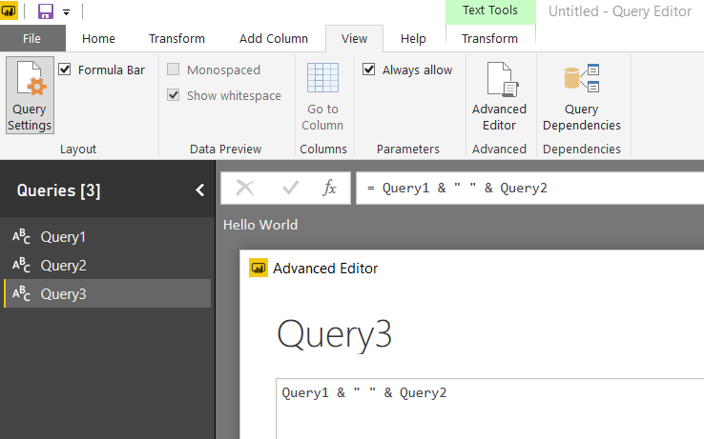
Referencing Other Queries
Query can reference other queries by name
Every query is defined with a return type

Slide 15
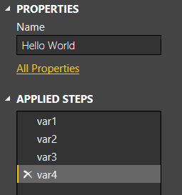
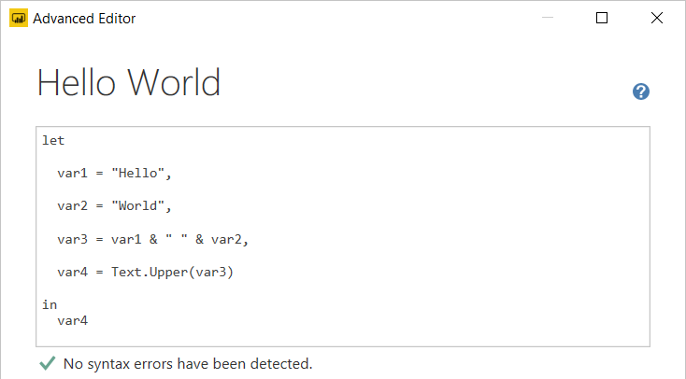
Let Statement
Queries usually created using let statement
Allows a single expressions to contain inner expressions
Each line in let block represents a separate expression
Each line in let block has variable which is named step
Each line in let block requires comma at end except for last line
Expression inside in block is returned as let statement value

Slide 16
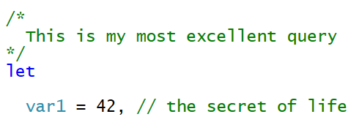
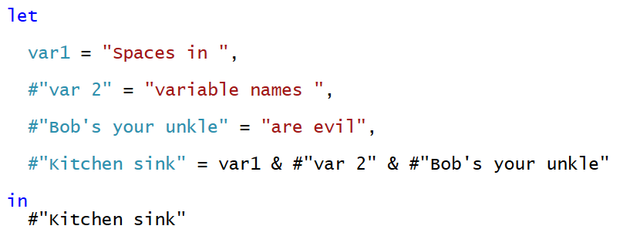
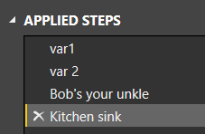
Comments and Variable Names
M supports using C-style comments
Multiline comments created using /* */
Single line comments created using //
Variable names with spaces must be enclosed in #" "
Variable names with spaces created automatically by query designer

Slide 17
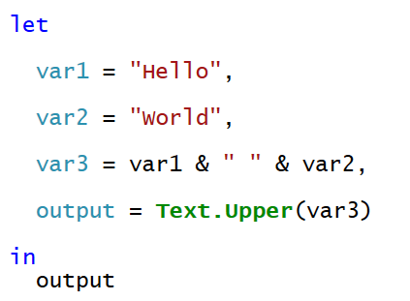
Flow of Statement Evaluation
Evaluation starts with expression inside in block
Expression evaluation triggers other expression evaluation

Slide 18
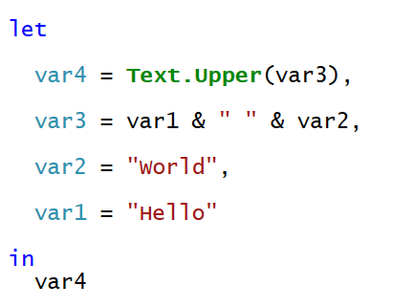
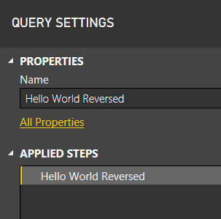
Will This M Code Work?
Yes, the Mashup Engine has no problem with this
The order of expressions in let block doesn't matter
However, the visual designer might get confused

Slide 19
Query Folding
Mashup engine pushes work back to datasource when possible
Column selection and row filtering
Joins, Group By, Aggregate Operations
Datasource that support folding
Relational database
Tabular and multidimensional databases
OData Web services
What happens when datasource doesn't support query folding?
All work is done locally by the mashup engine
Things that affect whether query folding occurs
The way you structure your M code
Privacy level of datasources
Native query execution

Slide 20
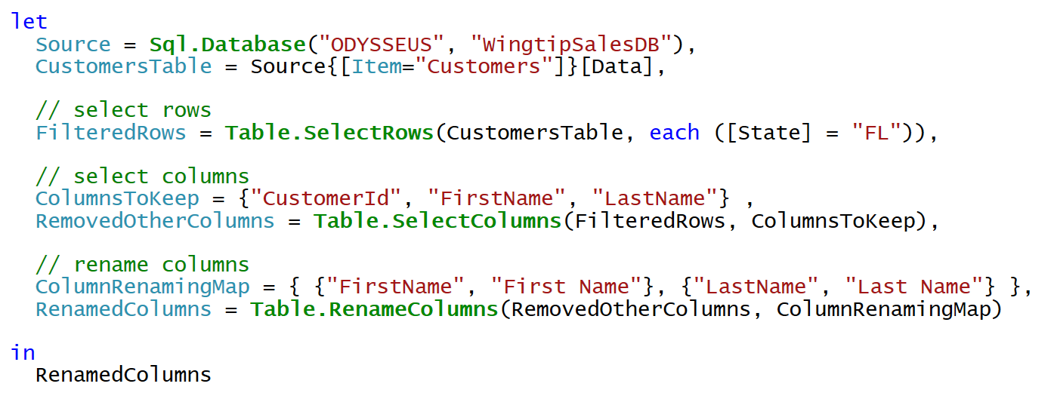
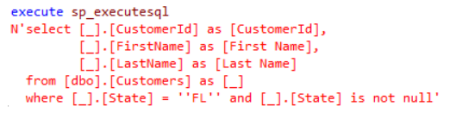
Query Folding Example
When you execute this query in Power BI Desktop…
Mashup Engine executes the following SQL query

Slide 21
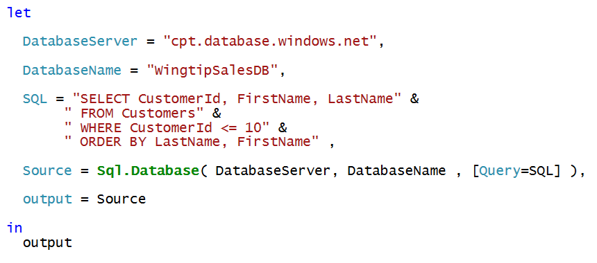
Native Queries
No query folding occurs after native query

Slide 22
M Type System
Built-in types
any, none
null, logical, number, text, binary
time, data, datetime, datetimezone, duration
Complex types
list, record, table, function
User-defined types
You can create custom types for records and tables

Slide 23
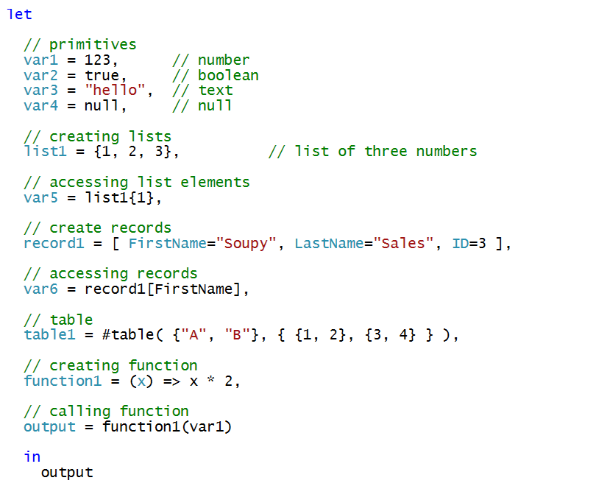
M Datatypes

Slide 24
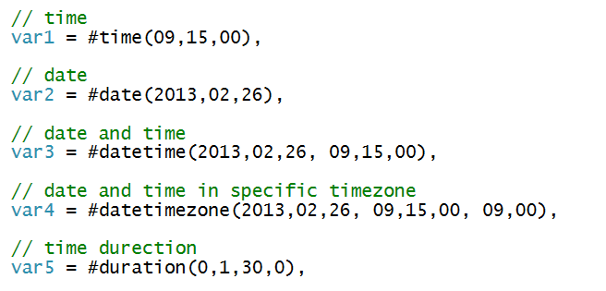
Initializing Dates and Times

Slide 25
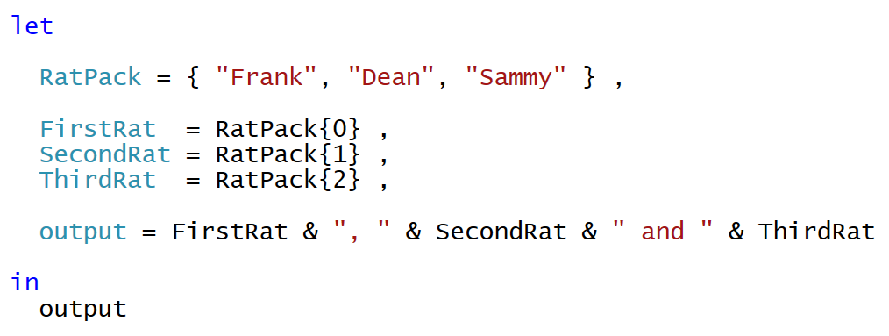
Lists
List is a single dimension array
Literal list can be created using { } operators
List elements accessed using { } operator and zero-based index
Use { }? to avoid error when index range is out-of-bounds

Slide 26
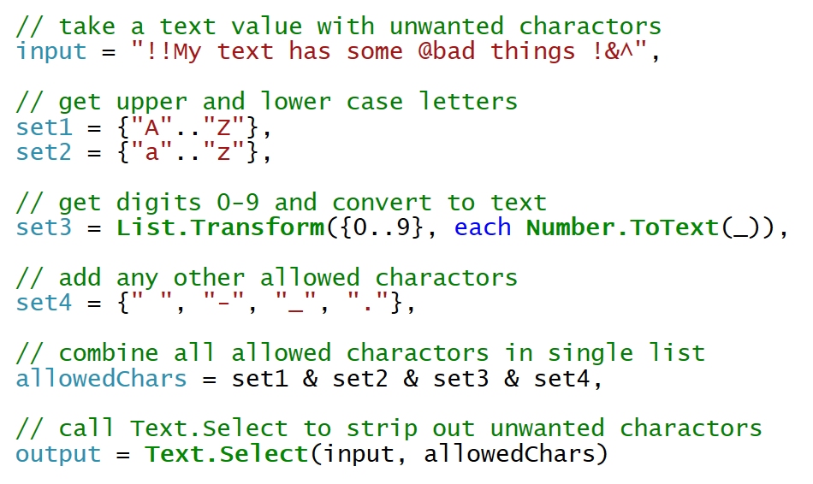
Text.Select
Text.Select can be used to clean up text value
You create a list of characters to include

Slide 27
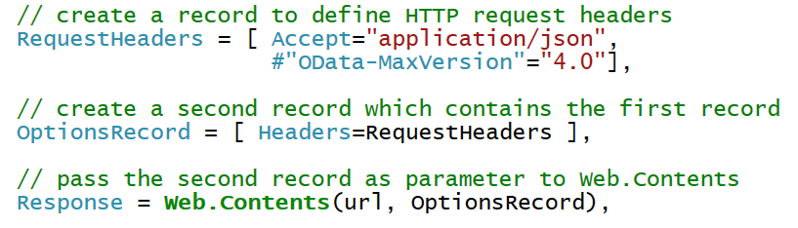
Records
Record contains fields for single instance of entity
You must often create records to call M library functions

Slide 28
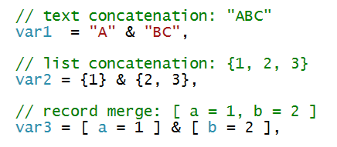
Combination Operator (&)
Used to combine strings, arrays and records

Slide 29
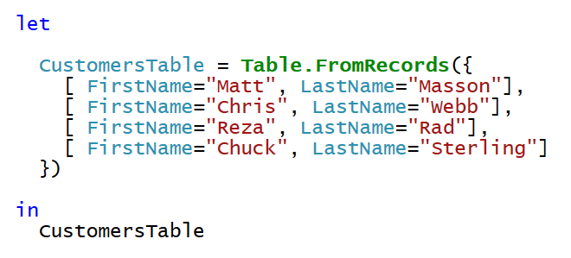
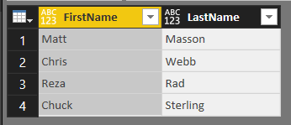
Table.FromRecords
Table.FromRecords can be used to create table
Table columns are not strongly typed
Bad, Bad, Bad ☹

Slide 30
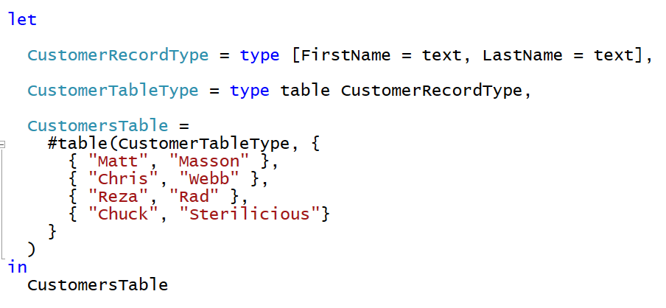
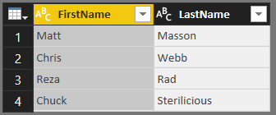
Creating User-defined Types
M allows you to create user-defined types
Here is a user-defined type for a record and a table
User-defined table used to create table with strongly typed columns

Slide 31

Using Each with Unary Functions
Many library functions take function as parameters
Function parameters are often unary (e.g. they accept 1 parameter)
M provides each syntax to make code easier to read/write
Unary parameter passed implicitly using _ variable
You can omit _ variable when accessing fields inside record
You must use _ variable when using each with a list

Slide 32
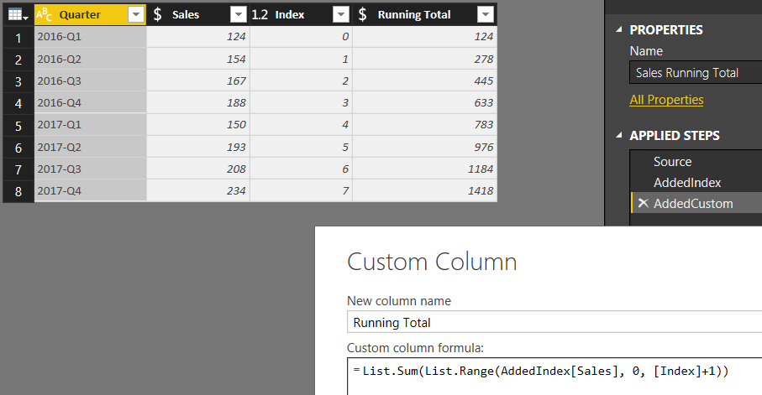
Performing Calculations Across Rows
Requires adding an index column

Slide 33
Agenda
Power Query Mashup Engine
M Programming Fundamentals
M Function Library
Query Functions
Query Parameters
Custom Data Connectors

Slide 34
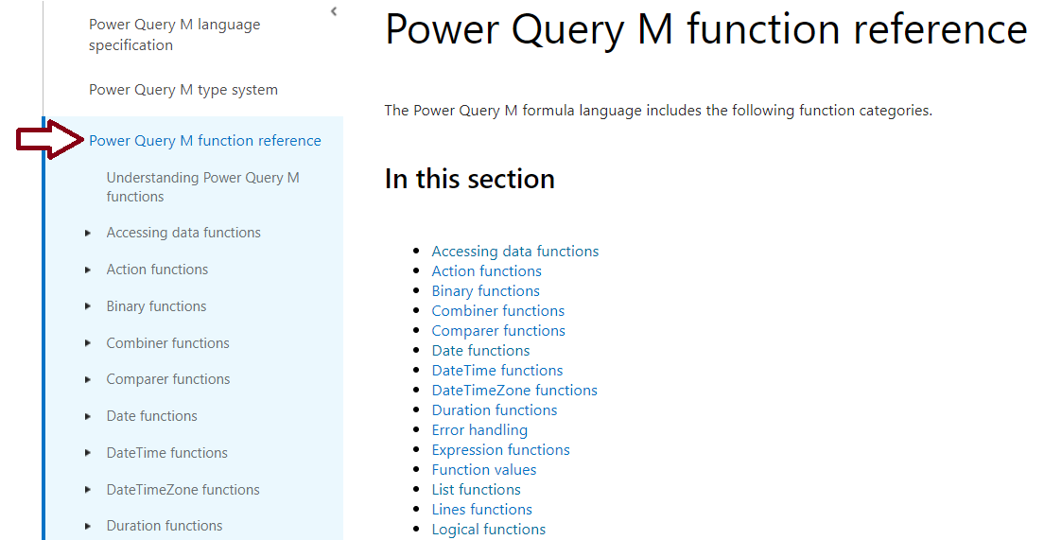
M Function Library
Check out the Power Query M function reference
https://msdn.microsoft.com/en-us/library/mt779182.aspx

Slide 35
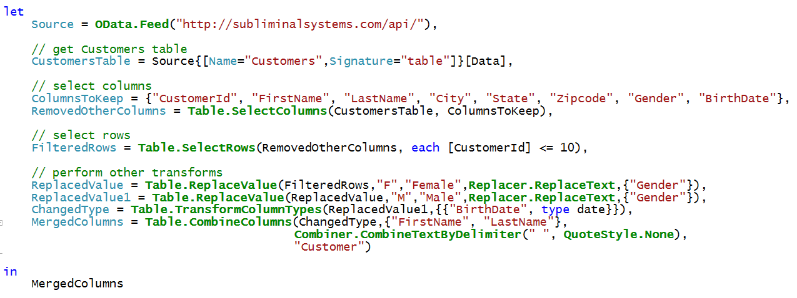
Accessing Data using OData.Feed
OData.Feed can pull data from OData web service
OData connector assists with navigation through entities
OData connector support query folding
OData makes extra calls to acquire metadata
Let's look at the execution of this query using Fiddler

Slide 36
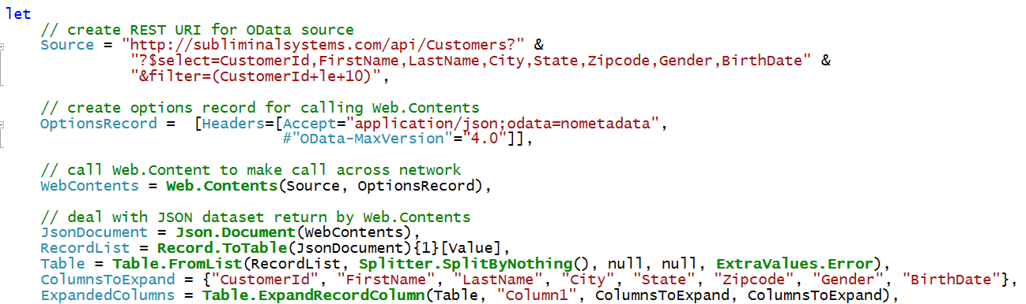
Web.Contents
Can be more efficient than OData.Feed
You can pass OData query string parameters (e.g. $select)

Slide 37
Agenda
Power Query Mashup Engine
M Programming Fundamentals
M Function Library
Query Functions
Query Parameters
Custom Data Connectors

Slide 38
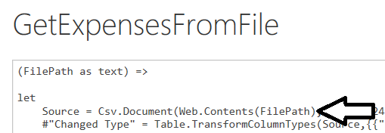
Understanding Function Queries
Query can be converted into reusable function
Requires editing query M code in Advanced Editor
Function query defined with one or more parameters
Function query can be called from other queries
Function query can be called using Invoke Custom Function
Function query can't be edited with visual designer

Slide 39
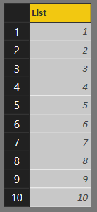
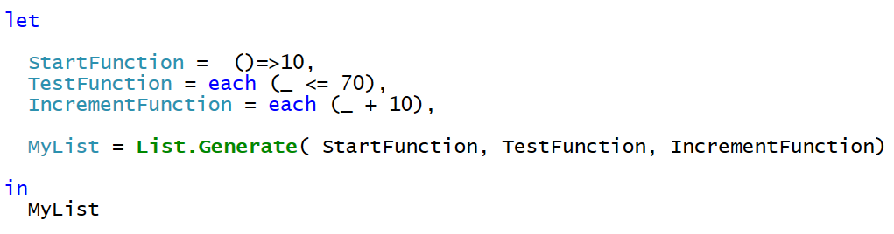
List.Generate
List.Generate accepts 3 function parameters
You can use each syntax for 2nd and 3rd parameter
You can optionally split functions out into separate expressions

Slide 40
Agenda
Power Query Mashup Engine
M Programming Fundamentals
M Function Library
Query Functions
Query Parameters
Custom Data Connectors

Slide 41
Query Parameters
What is a Query Parameter?
Configurable setting with project scope
Strongly-typed value to which you can apply restrictions
Can be referenced from a query
Selected values can be populated using list
Where are Parameters commonly used
To parameterize data source connection details
To filter rows when importing data
Notes:
In the summer of 2016, the Power BI team added new support to Power BI Desktop so that you can create configurable parameters within the scope of a Power BI Desktop project. The two primary scenarios for creating project parameters is to parameterize data source settings and to parameterize filter criteria used in queries.

Slide 42
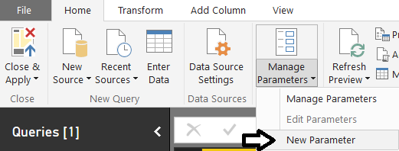
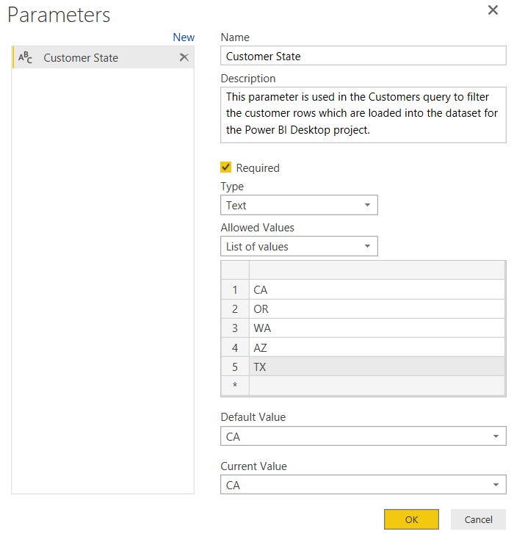
Creating Query Parameters
Parameters can be created using Manager Parameters menu
Parameter properties
Name
Description
Required
Allowed Values
Default Value
Current Value
Notes:
When you create a new parameter, you must give it a name and then you must configure its other properties. The Name property of a parameter is what you use when you need to reference the parameter. Each parameter has a Description property as well as a Required property and a Type which can be used to restrict the values which can be assigned to the parameter.
The Allowed Values property for a parameter provides even more control in configuring the allowed set of values for a given parameter. For instance, you can restrict the allowed values using a static list of values. The example show in the screenshot in the slides shows configuring a parameter to only accept values from a static list of states. . Users will then be able to pick one of these states when specifying the parameter value to use.
The Default Value property allows you to specify what the default value or selection should be used by default. The Current Value property allows you to specify the value that should be used for the parameter in the current report.

Slide 43
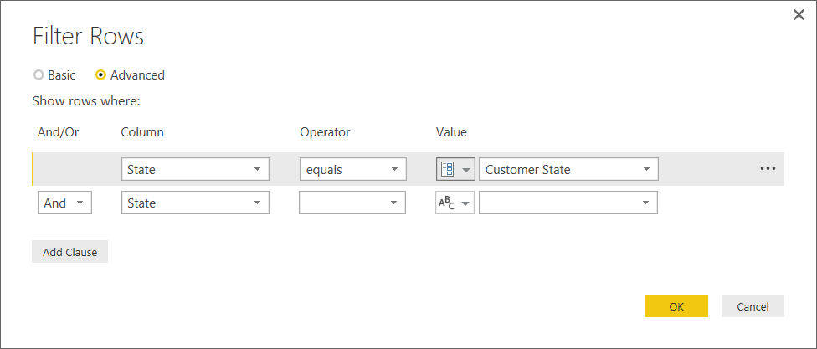
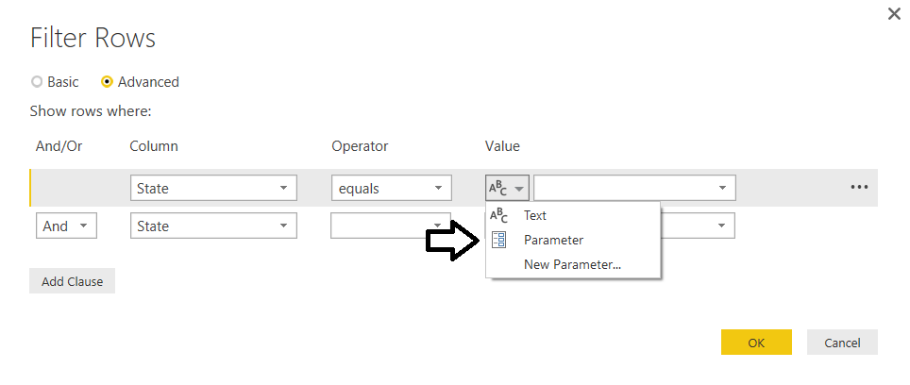
Referencing Parameters in a Query
Parameters can be referenced inside query
Next query execution uses current parameter value
Notes:
To use a parameter, you can reference it from one of the Power BI Desktop dialog boxes that allow you to configure data source settings or filter criteria in a query. However, you will find that many of the dialog boxes used by Power BI Desktop do not yet support configuring values using parameters. Over the next few months, the team that is updating Power BI desktop will continue to add support for using parameters to more of the application’s dialog boxes.

Slide 44
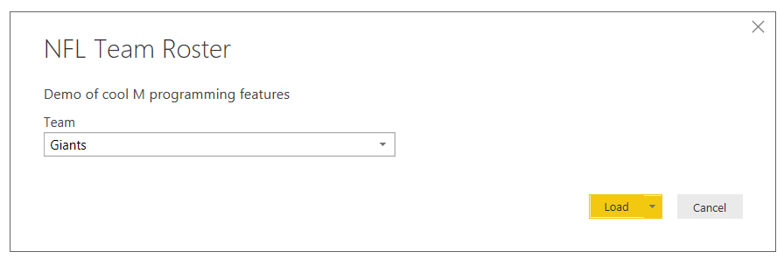
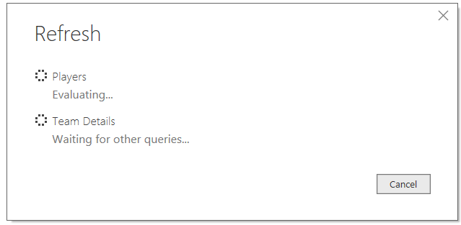
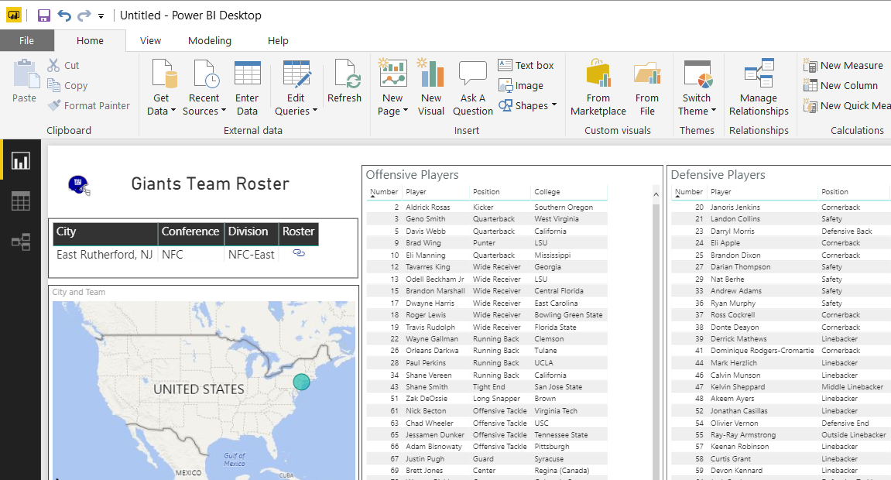
Creating a Project Template File

Slide 45
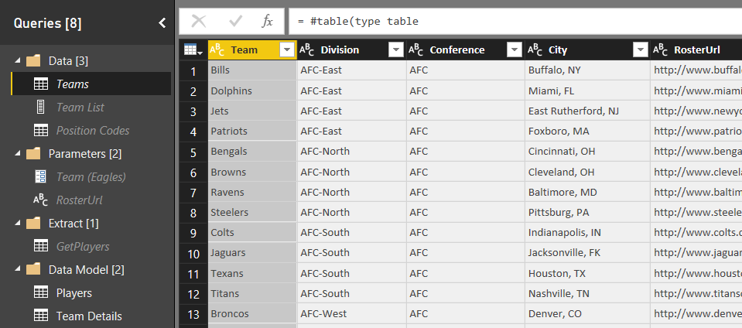
The Template File Implementation
Solution required advanced query design

Slide 46
Agenda
Power Query Mashup Engine
M Programming Fundamentals
M Function Library
Query Functions
Query Parameters
Custom Data Connectors

Slide 47
Motivation for Custom Data Connectors
Creating a business analyst friendly view for a REST API
Providing branding on top of existing connector (e.g. OData or ODBC driver)
Exposing a limited/filtered view over your data source to improve usability
Control how mashup engine authenticates against datasource
Implementing OAuth v2 authentication flow for a SaaS offering
Enabling Direct Query for a data source via an ODBC driver

Slide 48
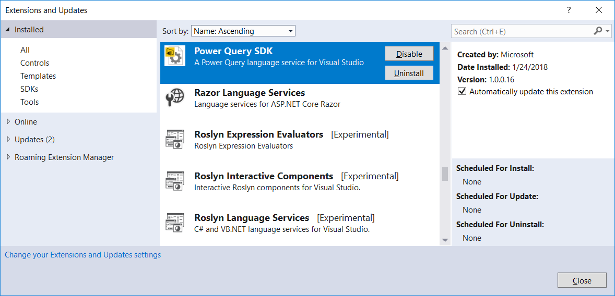
Power Query SDK

Slide 49
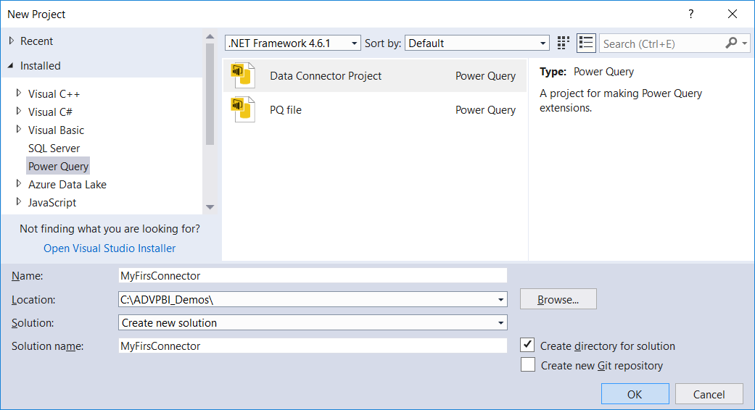
Creating a New Data Connector Project

Slide 50
The Microsoft Graph API
Designed as a one-stop-shopping kind of service
Abstracts away divisions between AD, Exchange and SharePoint
No need to discover endpoints using the Discovery Service
You can acquire and cache a single access token per user
Azure AD Data
Users
Groups
Your Client Application
Outlook Data
Mail
Calendar
Contacts
Microsoft Graph API
https://graph.Microsoft.com
SharePoint Data
OneDrive Files
Team Site Files

Slide 51
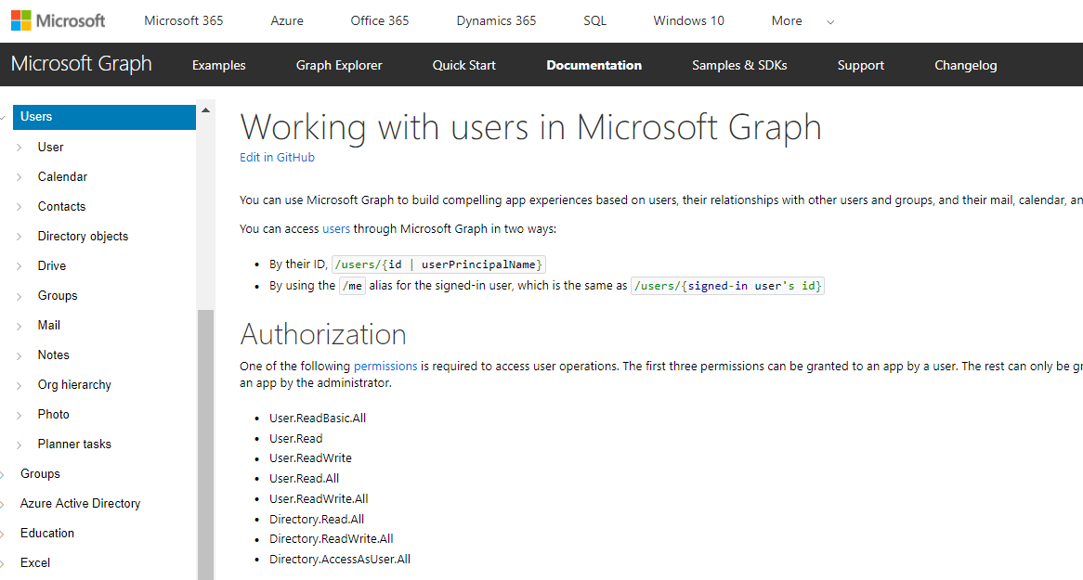
More Info on the Microsoft Graph API
https://developer.microsoft.com/en-us/graph/docs/api-reference/v1.0

Slide 52
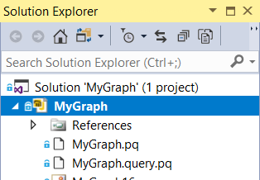
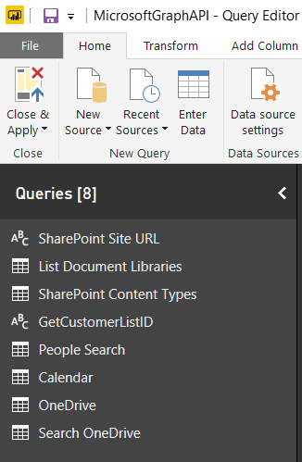
MyGraph Demo
Project originally created by Matt Masson
Connector designed to query Microsoft Graph API
Connector provides code to authenticate with OAuth2
Email Messages
Calendar Events
SharePoint Content
OneDrive Search
MyGraph.mez
OAuth2
Power BI Desktop Project
Custom Data Connector
Microsoft Graph API

Slide 53
Authorization Code Grant Flow
Sequence of Requests in Authorization Code Grant Flow
Application redirects to AAD authorization endpoint
User prompted to log on at Windows logon page
User prompted to consent to permissions (first access)
AAD redirects to application with authorization code
Application redirects to AAD access token endpoint
Request authorization code
Sign-in via browser pop-up
Return authorization code
Redeem authorization code and acquire access token for Office 365 resource
Return access token and refresh token
Call Microsoft Garph API using the access token
Return Http Response
Authorization Endpoint
Token Endpoint
Client Application
Microsoft Graph API

Slide 54
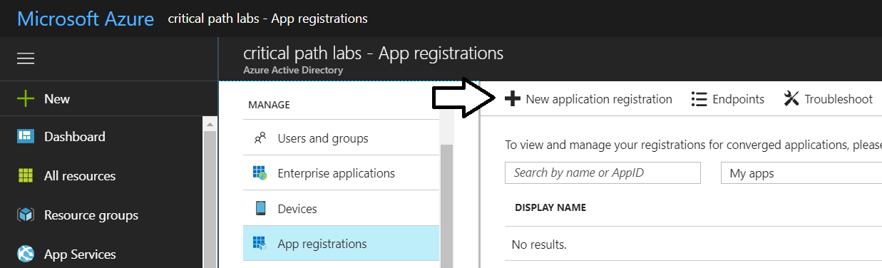
Registering an Azure Application
Can be done using Azure portal
Details you need for the custom data connector
Client ID
Client Secret
Redirect URL

Slide 55

Critical Path Training https://www.CriticalPathTrainig.com
DDPBI: Deep Dive into Power BI – 2 Days
For people just getting started with Power BI
DDPAF: Deep Dive into Power Apps and Flow – 2 Days
For people just getting started with Power Apps and Flow
PBI365: Power BI Certification Bootcamp – 3 Days
For people who have used Power BI Desktop for 6 months or more
PBD365: Power BI Developer Bootcamp – 4 Days
For professional developers working with the Power BI platform

Slide 56
Summary
Power Query Mashup Engine
M Programming Fundamentals
M Function Library
Query Functions
Query Parameters
Custom Data Connectors
Come see us present in Dublin

